Slide 1
Emission monitoring & reporting in Salzburg, Austria
Presentation for 893127 Air Pollution Control – 2020S
Shilan Grobbauer, 01440799

Slide 2
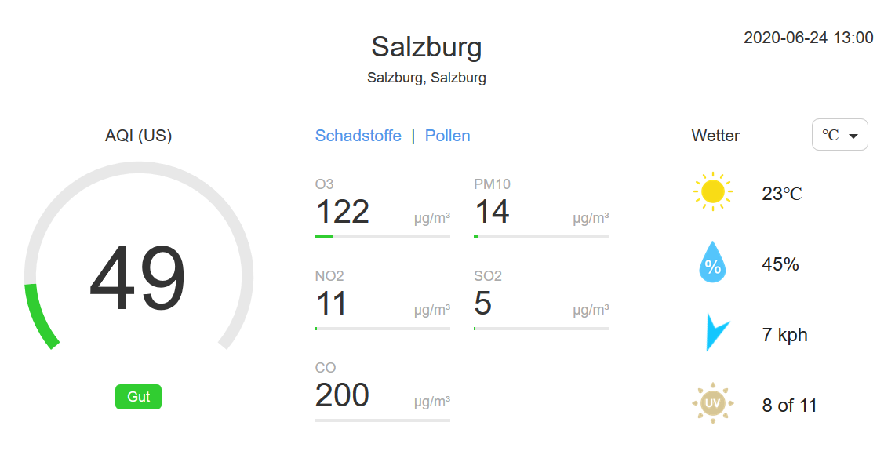
Overview Salzburg City
Source: https://air-quality.com/place/austria/salzburg/72a4f719?lang=de&standard=aqi_us
Date: June 24, 1:00 pm

Slide 3
SALIS – Air Quality Monitoring Network
More than 30 years ago, the introduction of the fully automated measuring network in Salzburg created an essential basis for the nationwide monitoring of air pollutants.
The concentration of air pollutants is recorded with the help of the fully automatic measuring network SALIS (= “SAlzburger Luftgüte Informations System”, Salzburg air quality information system).
The first computer-aided measuring network (Salis I) was installed in 1984. The current measuring network (Salis IV) was completely renewed in 1995 and is continuously adapted to the latest state of the art. The monitoring network consists on the one hand of permanent and mobile monitoring stations, and on the other hand of a monitoring centre where all data are stored and evaluated. The data collected by the measuring stations are retrieved from the central computer every half hour. Limit value violations are automatically forwarded by this system to the on-call service.
Source: https://www.salzburg.gv.at/themen/umwelt/luft/luftberichte/luftguetemessnetz

Slide 4
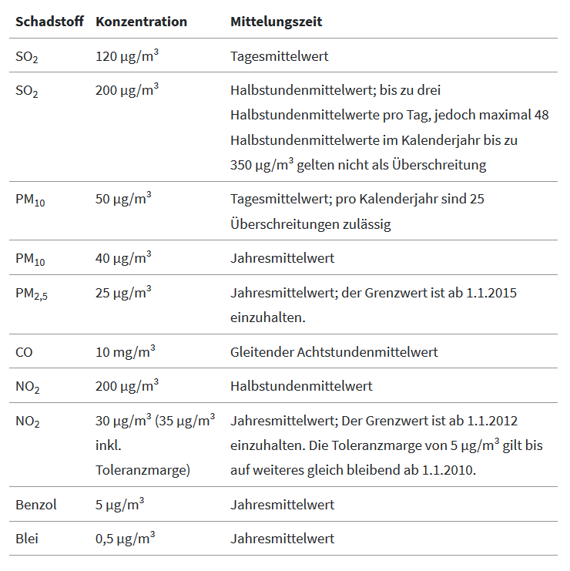
Immission limit values in Austria
Source: https://www.umweltbundesamt.at/luft

Slide 5
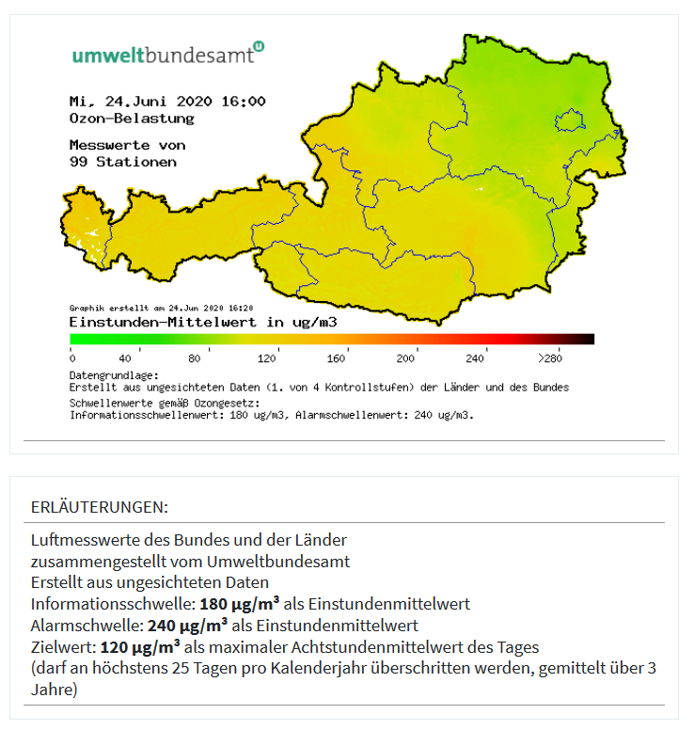
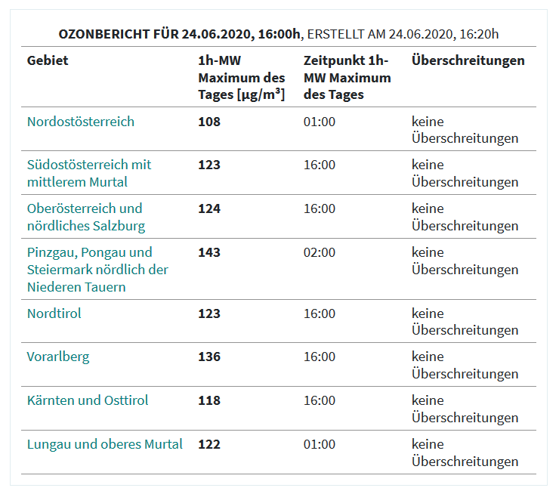
Ozone in Austria
Source: https://www.umweltbundesamt.at/ozonwerte-vom-vortag-1
Date: June 24, 4:00 pm

Slide 6
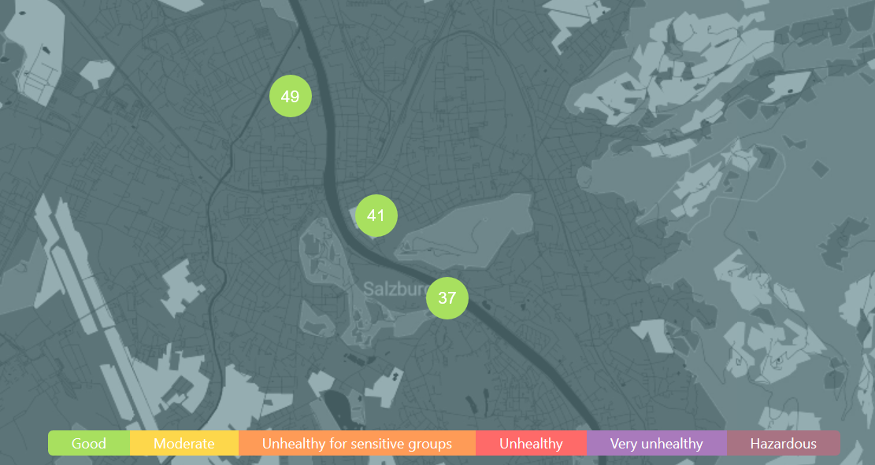
Measuring stations in Salzburg - 1
Source: https://www.iqair.com/air-quality-map?lat=47.81722222222223&lng=13.030833333333334&zoomLevel=10
Date: June 24, 1:00 pm

Slide 7
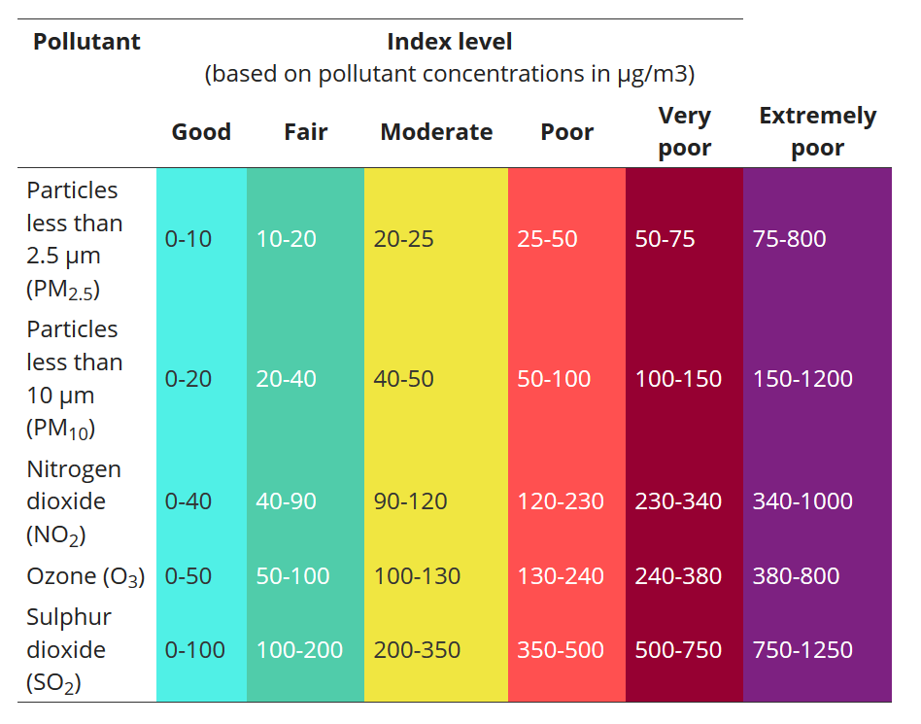
European Air Quality Index
Measuring stations in Salzburg – 2a
Source: https://airindex.eea.europa.eu/Map/AQI/Viewer/

Slide 8
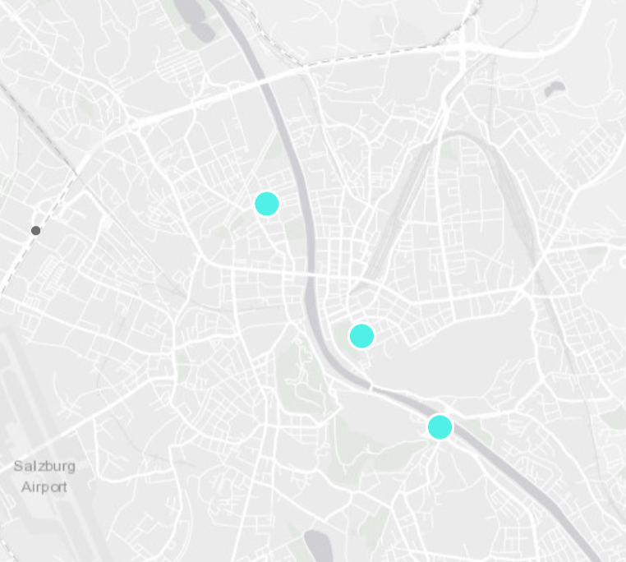
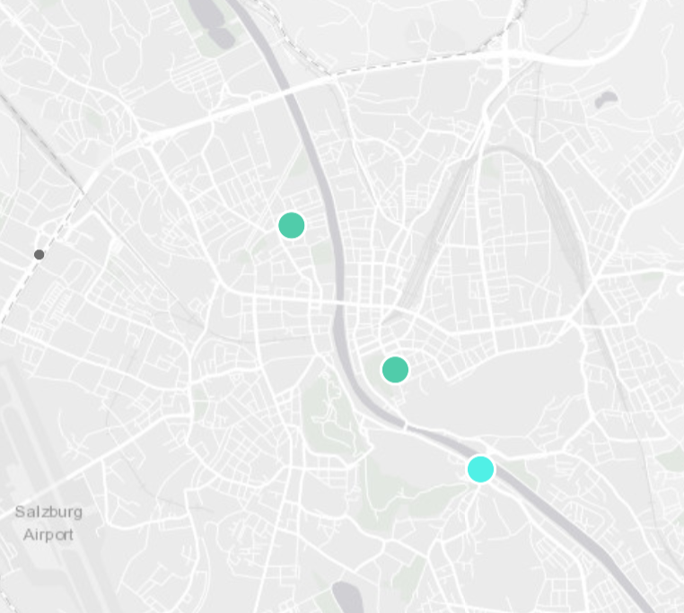
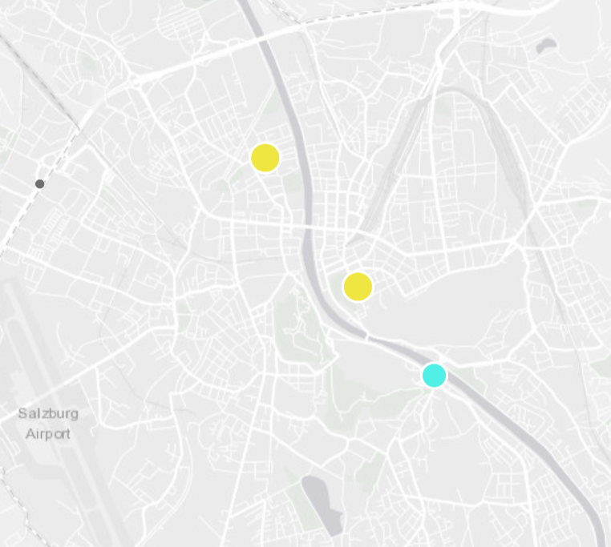
European Air Quality Index
Measuring stations in Salzburg – 2b
Source: https://airindex.eea.europa.eu/Map/AQI/Viewer/
Date: June 23, (1) 10:00 am, (2) 2:00 pm, (3) 5:00 pm

Slide 9
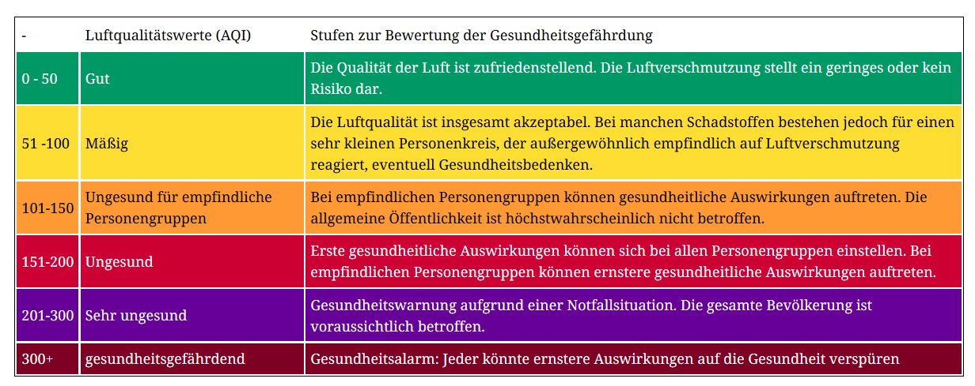
Measuring stations in Salzburg – 3
There are 3 stationary measuring stations in Salzburg
Franz Martin-Straße 1
Mirabellplatz
Rudolphsplatz
Following slides: history of 3 criteria pollutants: SO₂, NO₂, PM₁₀
Index for the following 3 slides: green = good

Slide 10
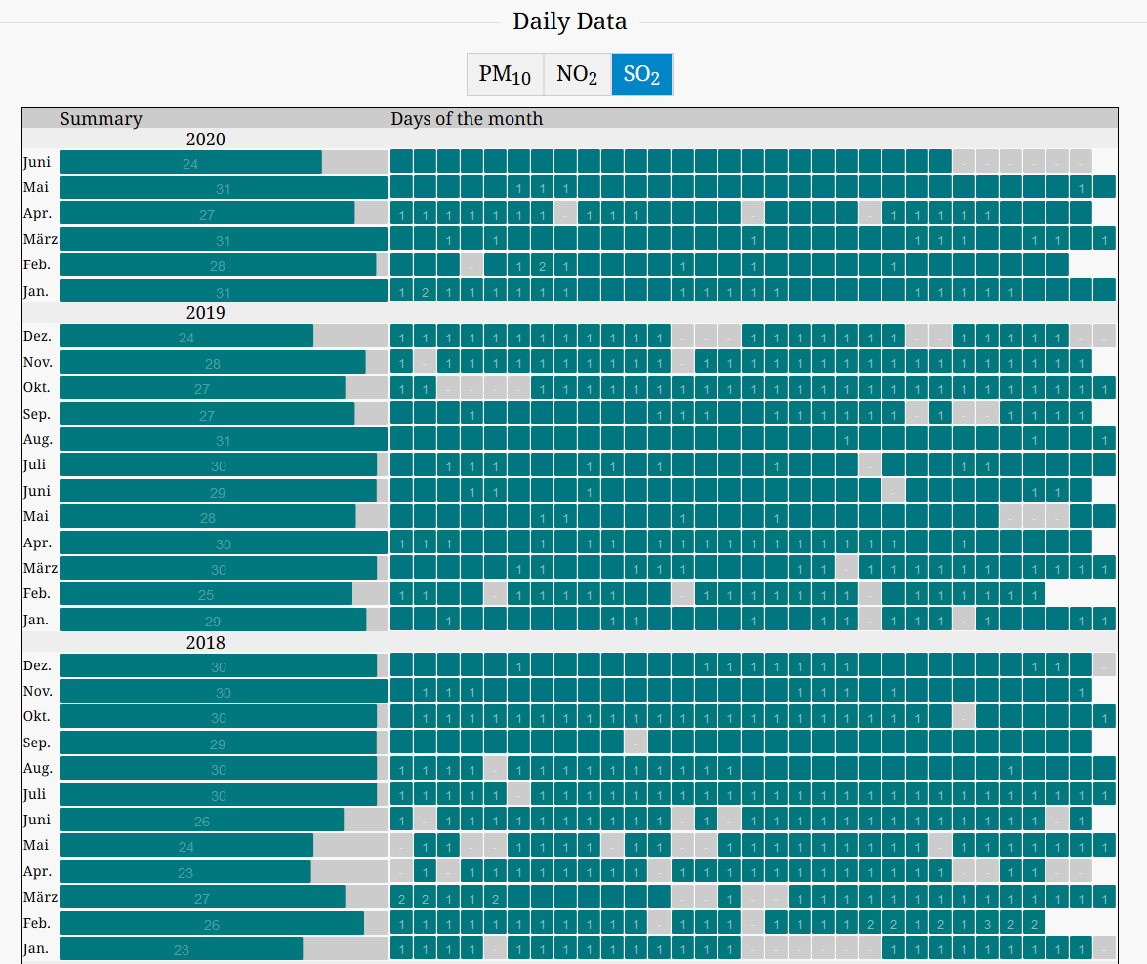
Franz Martin-Straße 1
SO₂ for the last 30 months
Source: https://aqicn.org/city/austria/franz-martin-strasse-1/de/

Slide 11
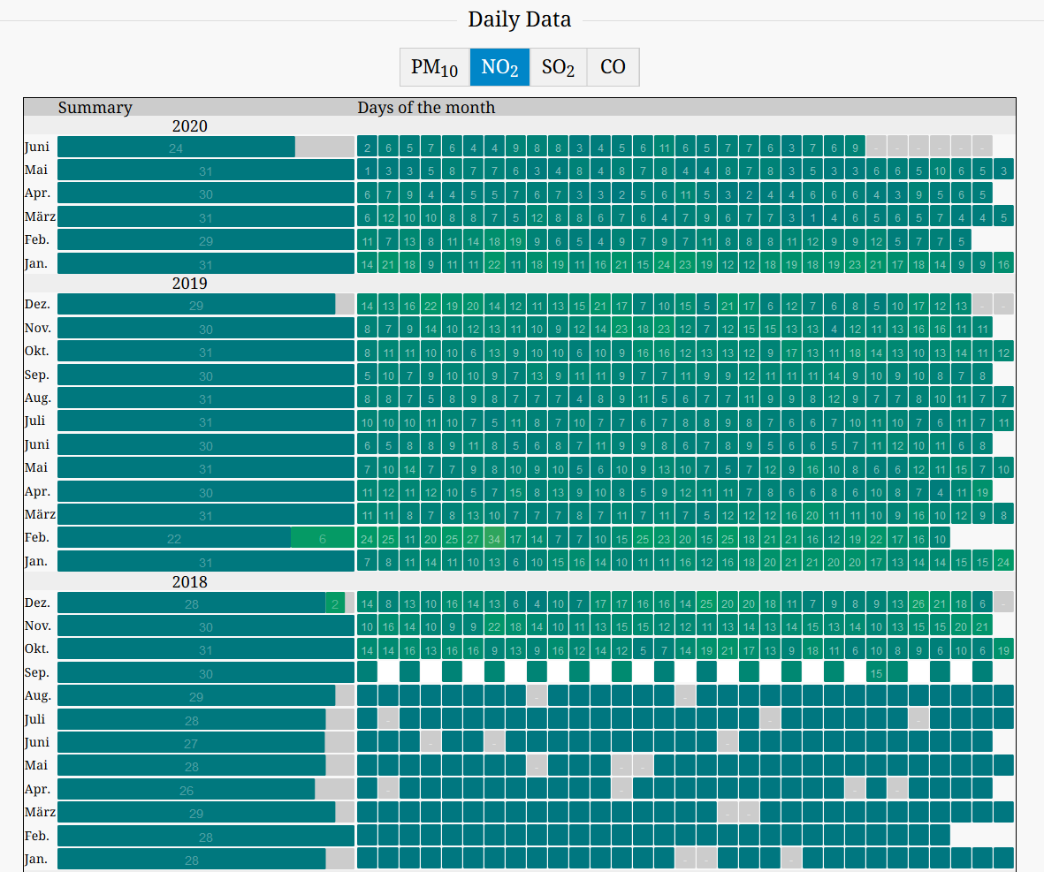
Mirabellplatz
NO₂ for the last 30 months
Source: https://aqicn.org/city/austria/mirabellplatz/de/

Slide 12
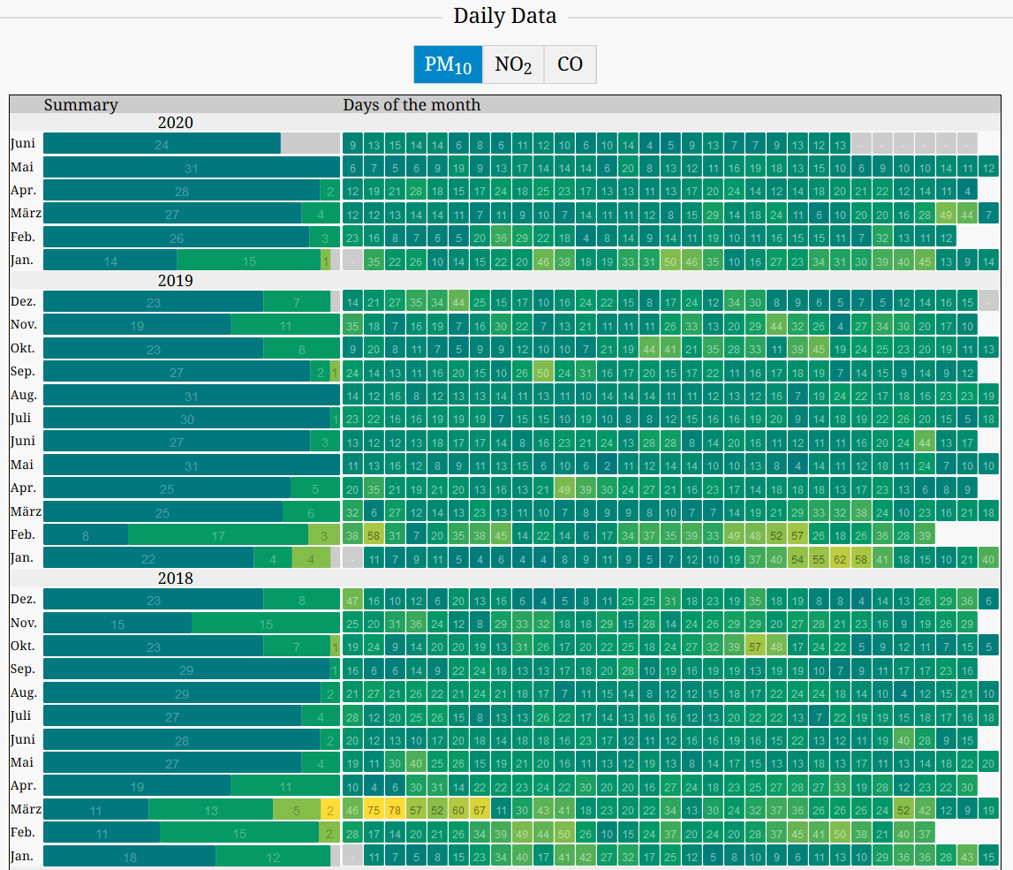
Rudolphsplatz
PM₁₀ for the last 30 months
Source: http://aqicn.org/city/austria/rudolfsplatz-grunflache-in-der-mitte/de/

Slide 13
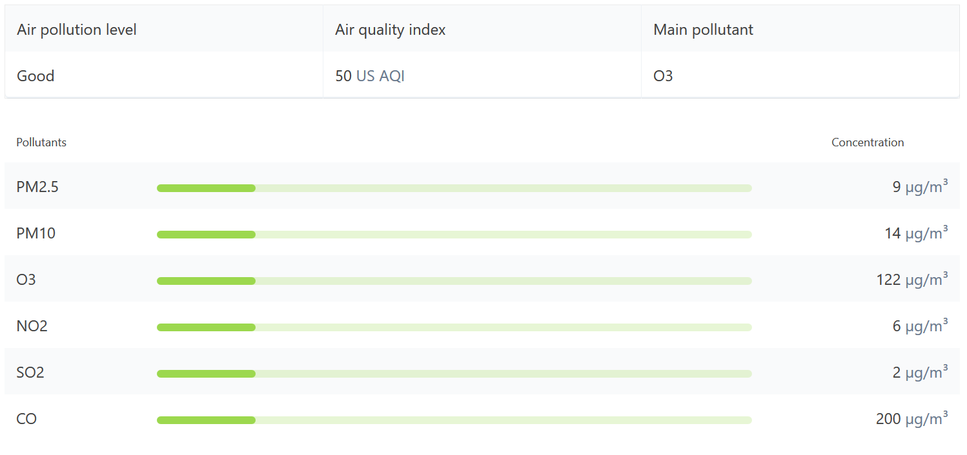
Relevant Pollutants in Salzburg
Source: https://www.iqair.com/austria/salzburg
Date: June 24, 12:00 (noon)

