Slide 1
Stationary Emission Monitoring and Reporting
-
In Europe and France
Fauchoix Romain - 22 October 2024

Slide 2
Table of contents
01
02
03
Current Regulatory Framework
Case Study:
Albioma
Case Study:
SYTEVOM
Europe & France
Réunion Island (France)
Noidans le Ferroux (France)
04
05
Challenges & Future Trends
Conclusion

Slide 3
01
Current Regulatory Framework

Slide 4
Current Regulatory Framework - Europe
EU Emissions Trading System (ETS):
One of the largest carbon markets globally, designed to cap total GHG emissions from sectors like energy, manufacturing, and aviation.
Industries are allocated a specific number of emission allowances, which they can trade. The number of allowances is reduced annually.
By 2023, the EU ETS has helped bring down emissions from European power and industry plants by approximately 47%, compared to 2005 levels.
In 2023, the ETS was reformed to align with the 2030 emissions reduction targets, introducing stricter caps, enhanced monitoring, and expanding coverage to maritime transport (Reduce emissions by 62% by 2030).
Industrial Emissions Directive (IED):
The IED complements the EU ETS by covering a broader range of pollutants beyond GHG emissions.
Aimed at reducing emissions of pollutants like PM, NO_{x}, and SO₂ from industrial activities.
The plan to lower emissions is based on Best available technology (BAT) to help reach the goals of the directive (most environmentally effective, economically and technically viable).

Slide 5
Current Regulatory Framework - France
Grenelle II Law (France):
Enforces environmental accountability across industries in France by mandating monitoring and reporting of environmental impacts, including emissions.
Aligns with EU regulations such as the ETS and IED, with a focus on broader environmental governance within France.
Industries must ensure they meet national environmental goals by reporting their emissions and following compliance standards.
ICPE (Classified Installations for Environmental Protection):
Regulates French industrial facilities that pose environmental risks under the French Environmental Code.
Classifies installations based on their potential environmental impact and sets legal obligations for emission monitoring, reporting, and risk management.
Facilities handling dangerous substances must undergo regular inspections and submit environmental impact assessments before operations, ensuring compliance with pollution limits and transparency.

Slide 6
Current Regulatory Framework - France
Bilan Carbone Tool:
Developed by ADEME (French Agency for Ecological Transition) to help organizations assess and report their GHG emissions in compliance with the EU ETS and other regulatory requirements..
Provides a standardized framework for carbon accounting, aligning with international standards and EU regulations.
National Low Carbon Strategy (SNBC):
France’s Stratégie Nationale Bas-Carbone (SNBC) sets a roadmap to achieve carbon neutrality by 2050.
Establishes legally binding carbon budgets and requires enhanced emissions monitoring for industries to adhere to.
Supports national efforts to comply with both national and international climate goals (Kyoto Protocol, Paris Agreement, ...).

Slide 7
02
Case study
-
Albioma

Slide 8
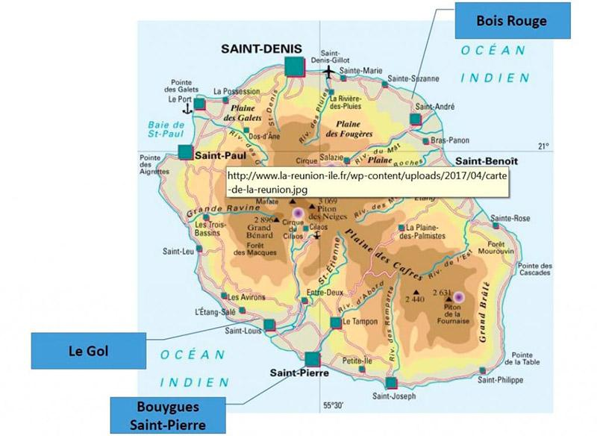
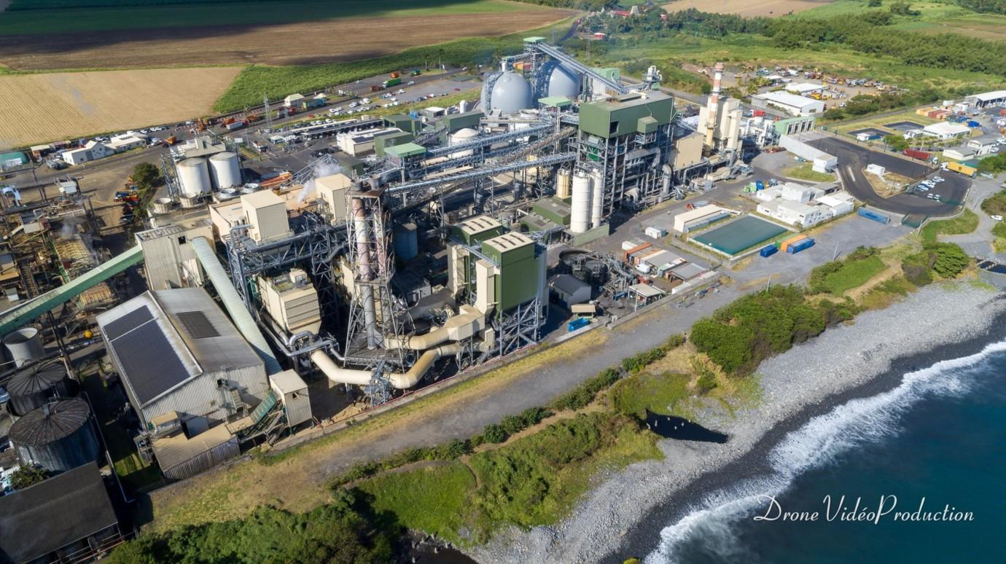
Albioma Thermal Biomass Power Stations
Cutting-edge projects in the Réunion Island focusing on renewable energy solutions.
Aim to reduce industrial pollution and support sustainable development.
Ecosite Label: Awarded for biodiversity protection and sustainable construction practices for the Saint-Pierre’s site (2019).
Since 2023, the three power plants have transitioned to operate entirely on local biomass, utilising by-products and waste from sugarcane use, and no longer rely on coal.
Reunion Island map
Albioma, Bois-Rouge power plant
Ref: Albioma

Slide 9

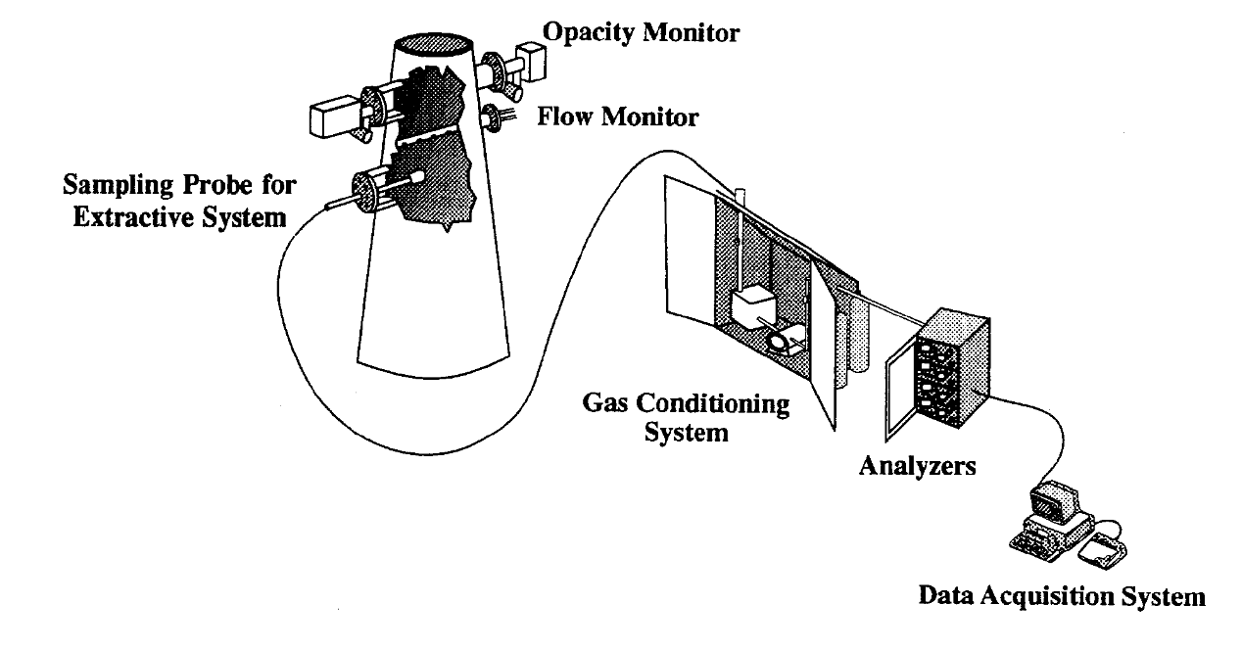
ENVEA’s Continuous Emission Monitoring Systems (CEMS)
ENVEA logo
ENVEA is a leading global provider environmental management solutions for the protection of people and planet.
The company specializes in the design and manufacture of advanced systems for monitoring air quality, industrial processes’ emissions.
It helps companies and governments to comply with French and European regulations.
A Typical Continuous Emission Monitoring System
Ref: Envea

Slide 10
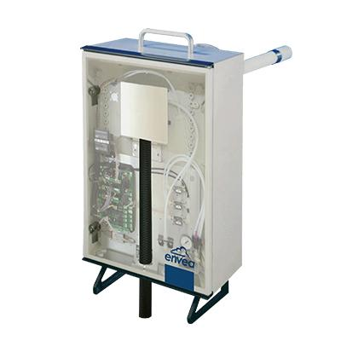
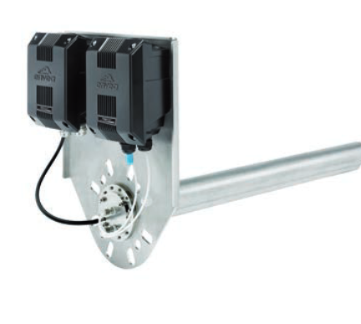
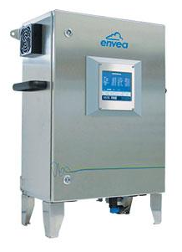
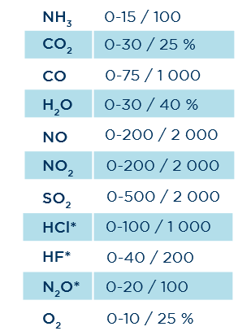
Continuous Emission Monitoring Systems
HOFI Box
Stack Gas Sampling System
STACKFLOW 200 Flowmeters
Stackflow 200 uses an Averaging Pitot technology to provide continuous flue gas Velocity, Temperature, and Pressure measurement.
The HOFI box is designed for stack gas sampling, with high particulate, moisture content and corrosive properties (Hot Wet direct extractive sampling system)
The MIR 9000H analyzer measures from 1 to 8 gas parameters, using combination of infrared spectroscopy with gas filter correlation technologies.
MIR 9000H
Heated Multi-gas Analyzer
Ref: Envea

Slide 11
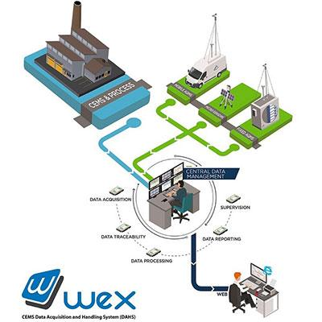
Centralized Data Handling
Aggregates emission data across multiple locations.
Automatic backup system ensures no data loss.
Key Features of WEX software:
Calculates and aggregates data through scaling, correction, linearization, and normalization over various time periods.
Includes Emission Limit Value exceedance detection and trend monitoring for early warning alerts and reporting.
Optimizes CEMS performance to minimize the risk of excess emissions.
WEX
Data processing and emissions reporting software
2 stacks:
HCl, SO_{2,} NO_{x}, CO, H₂O, O₂, and NH₃
General Electric (GE) desulfurization installation (DeSOx):
HCl, SO₂, H₂O, O₂ and NH₃
4 MIR 9000H per plant
Main chimney:
SO₂, NO_{x}, CO, H₂O, O₂ and NH₃
Ref: Envea

Slide 12
03
Case study
-
SYTEVOM

Slide 13
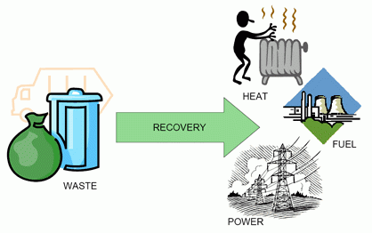

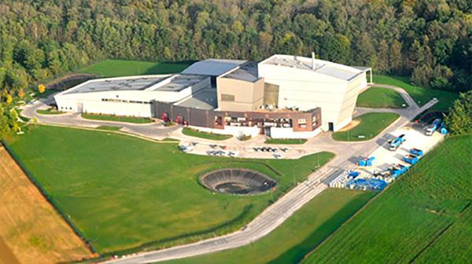
SYTEVOM Waste-to-Energy (WtE) plant
Suez logo
WtE principle
The WtE plant is operated by Suez RV Energie but belongs to SYTEVOM (association for the transfer, disposal and recycling of household waste).
It treats 41,000 tonnes per year of household waste and produces 17 GW of electricity mostly for self-consumption
Mercury can be generated from batteries and other materials in waste when burned.
New Best Available Techniques Reference Document (BREF) guidelines require compliance with BAT Associated Emission Levels by December 2023, necessitating mercury CEMS.
WtE plant of Noidans le Ferroux
Ref:

Slide 14
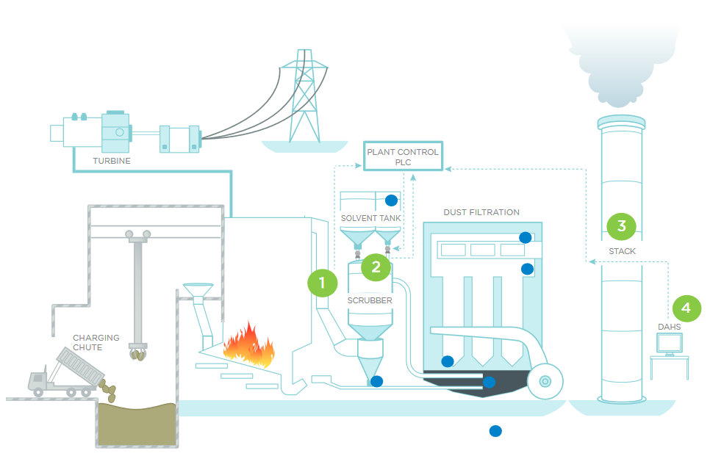
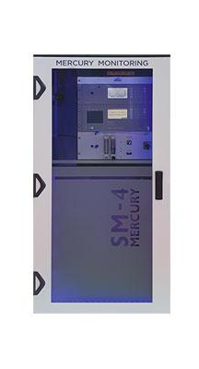
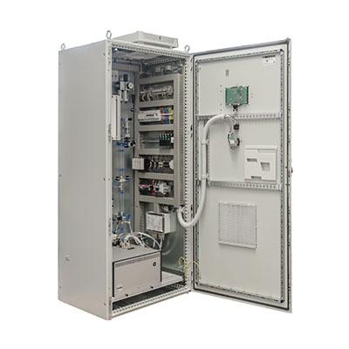
ENVEA’s Mercury CEMS
Waste incineration process scheme
Neutralization or absorption of mercury prior to dust filtration is achieved by injecting lignite coke (2)
The extractive sampling is performed without dilution and with a ceramic filter (3)
All forms of oxidized or particulate mercury Hg^{n+} into elemental mercury Hg⁰ thermally (950°C) followed by Cold Vapor Atomic Absorption Spectroscopy (CVAAS) (3)
Optimisation and control of the whole flue gas conditioning process with the use of ENVEA’s WEX (4)
SM-4 mercury CEMS
Mercury emissions monitor in raw gas, upstream of
exhaust treatments (1)
SM-5 mercury CEMS
Total mercury emissions monitor in stack flue gases (3)
Ref: Envea

Slide 15
04
Challenges & Future Trends

Slide 16
Challenges
High Costs and Maintenance: Installing, maintaining, and upgrading monitoring technologies, especially for small and medium-sized enterprises (SMEs), remains expensive.
Complex Regulatory Landscape: Navigating overlapping regulations like the EU Emissions Trading System (ETS), Industrial Emissions Directive (IED), and country-specific laws is challenging for industries. Ensuring compliance across multiple regulatory frameworks increases administrative burdens.
Data Management: Handling vast amounts of emissions data, ensuring its integrity, and timely reporting to regulators can be difficult without advanced digital infrastructure.

Slide 17
Future Trends
AI and Machine Learning: AI and machine learning technologies are transforming emission monitoring by analyzing data from sensors, machines, and satellite imagery. These technologies identify patterns, optimize processes, and provide real-time insights, helping companies efficiently track and reduce emissions, improving compliance and cost-effectiveness.
Advanced Carbon Capture Technologies: As emission reduction technologies like carbon capture and storage (CCS) evolve, the need for precise monitoring of captured emissions will increase.
Stricter Regulations: Upcoming regulations will impose tighter emissions caps and require more detailed monitoring and reporting, especially with the 2023 revision of the EU ETS and the introduction of ETS2 for buildings and road transport in 2027.

Slide 18
05
Conclusion

Slide 19
Conclusion
Regulatory Framework: The EU ETS/IED and France’s Grenelle II Law enforce strict emission monitoring and reduction targets.
Technological Solutions: Advanced monitoring systems like ENVEA’s CEMS are crucial for compliance and effective emission management.
Future Trends: AI, machine learning and stricter regulations are transforming emission monitoring and reduction efforts.

Slide 20
Bibliographical references
wad. « 12 CEMS with Centralized DAHS for La Reunion ». ENVEA, 10 février 2018, https://www.envea.global/12-cems-with-centralized-dahs-for-la-reunion/.
Stratégie Nationale Bas-Carbone (SNBC) | Ministère du Partenariat avec les territoires et de la Décentralisation Ministère de la Transition écologique, de l’Énergie, du Climat et de la Prévention des risques Ministère du Logement et de la Rénovation urbaine. https://www.ecologie.gouv.fr/politiques-publiques/strategie-nationale-bas-carbone-snbc.
What Is the EU ETS? - European Commission. https://climate.ec.europa.eu/eu-action/eu-emissions-trading-system-eu-ets/what-eu-ets_en.
Industrial and Livestock Rearing Emissions Directive (IED 2.0) - European Commission. 10 octobre 2024, https://environment.ec.europa.eu/topics/industrial-emissions-and-safety/industrial-and-livestock-rearing-emissions-directive-ied-20_en.
wad. « Waste-to-Energy Plant (France) Selects ENVEA for Mercury Monitoring and Compliance with the Waste Incineration BREF ». ENVEA, 12 septembre 2023, https://www.envea.global/waste-to-energy-plant-france-selects-envea-for-mercury-monitoring-and-compliance-with-the-waste-incineration-bref/.
wad. « A Global Solution for Mercury Monitoring ». ENVEA, 5 avril 2022, https://www.envea.global/a-global-solution-for-mercury-monitoring/.
Reducing Air Pollution: Policies That Pay off | CNRS. 13 janvier 2022, https://www.cnrs.fr/en/press/reducing-air-pollution-policies-pay.
« La Réunion ». Albioma, https://www.albioma.com/en/site/reunion-island/.
ETS2: Buildings, Road Transport and Additional Sectors - European Commission. https://climate.ec.europa.eu/eu-action/eu-emissions-trading-system-eu-ets/ets2-buildings-road-transport-and-additional-sectors_en.
Document Display (PURL) | NSCEP | US EPA. https://nepis.epa.gov/Exe/ZyPURL.cgi?Dockey=00000ODO.txt.

