Slide 1
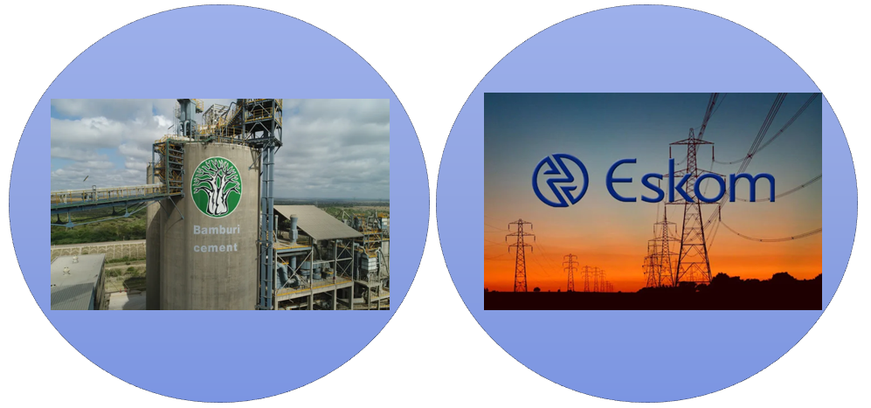

Stationary Emission Monitoring and Reporting in Kenya and South Africa
Case Study of Bamburi Cement (Ke) and Eskom (SA)
Presenters: Joas Koech and Yvonne Ouma

Slide 2

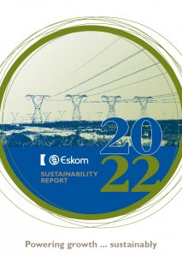
Why EM and Reporting in Stationary Sources
Sustainability Targets
(Green Labels)
Comply with Existing Laws and Regulations
(Statutory Limits)

Slide 3
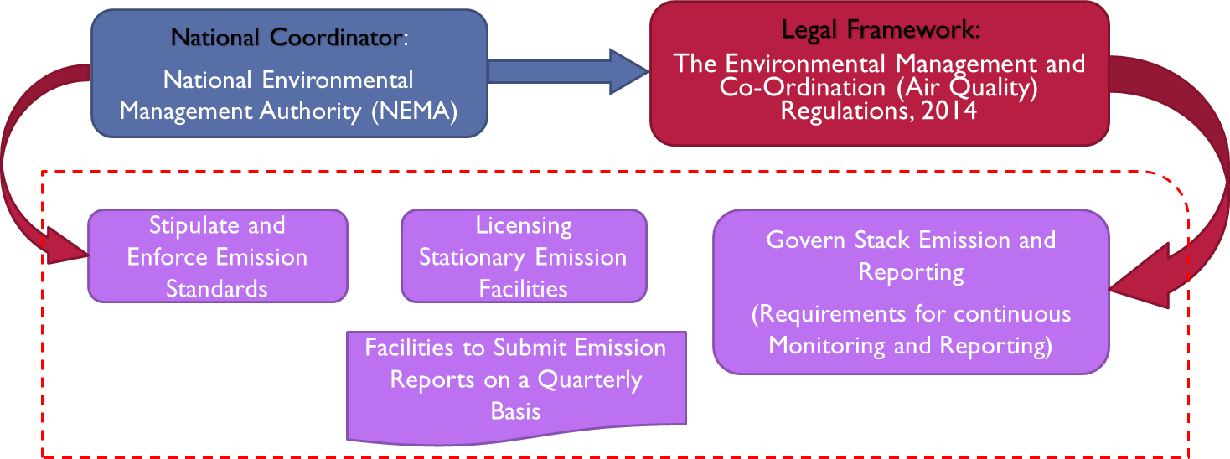
Institutional and Regulatory Framework in Kenya
Source: EMCA, 2014

Slide 4
Emission Standards for Cement Plants in Kenya
    PM₁₀
    SO_{x}
    NO_{x}
    Hydrocarbons
    Dioxins/Furans
    Carbon monoxide
  PM₁₀ = 50mg/Nm³
  SO_{x} = 400mg/Nm³
  NO_{x} = 1500mg/Nm³
  CO₂ = 500mg/Nm³
  Hydrocarbons = 300mg/Nm³
  Dioxins/Furans = 0.5 mg/Nm³
Monitored Parameters
Emission Limits
Source: EMCA, 2014

Slide 5
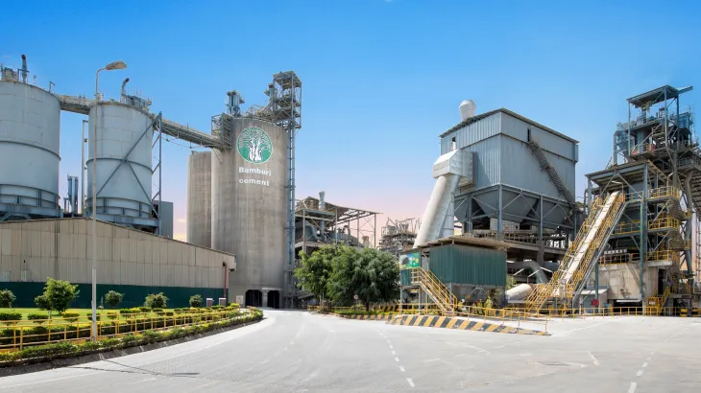
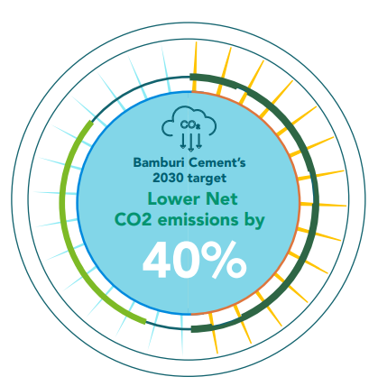
Case Study of Bamburi Cement
Manufacture cement and cement-related products
Produces around 5000 tons per day
60% CO₂ emissions from Material transformation, and 40% flue gas and PM from coal combustion to supply heat
Founded in 1951. Part of the Lafarge group of companies
Profile
Source: https://www.lafarge.co.ke/cement-manufacturing-process
Source: Bamburi cement Sustainability report (2022)

Slide 6
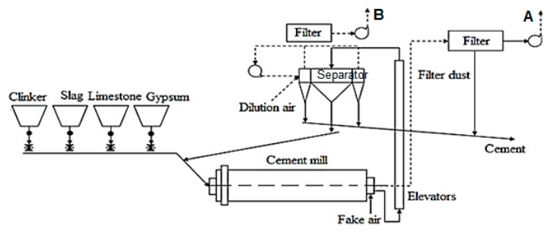
Typical Flowchart of Cement Grinding
Process Flow of Cement Grinding; A and B are Evacuation Stacks (Monitoring Points); Source: Ciobanu, et al (2021)

Slide 7
Installation of EMS in Bamburi Cement (1)
The EMS system in the plant monitors NOx, SOx, and Dust (PM).
The NOx , SOx, including dioxins, furans, and VOC, are released in tiny and unpredictable quantities from the combustion fuels.
The dust from the company arises from combustion kilns
The plant uses an automated real-time monitoring system.
Source: Bamburi Cement Sustainability Report (2022)_Decarbonizing operations

Slide 8
Installation of EMS in Bamburi Cement (2)
The system employs a Technical Information System (TIS) for analysis and display of Stack data.
The system uses various probes to extract stack samples and transmit them to the TIS analyzer.
The processed data is used for reporting emission status
Bamburi-cement-sustainability-report (2021)_Committed to sustainable future

Slide 9
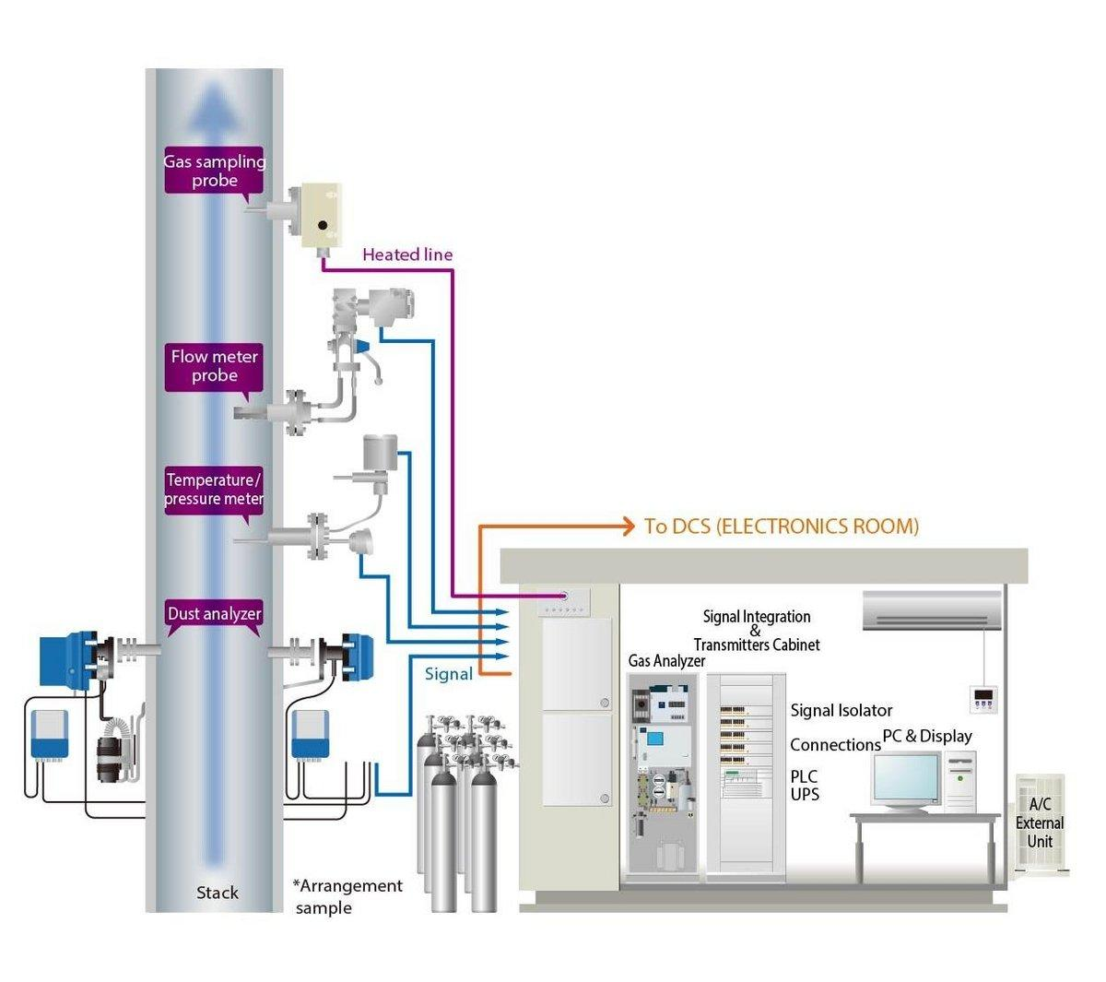
Procured and Installed EMS technology
The company discloses that it uses HORIBA CEMS technology in its plants.
The technology measures dust and target flue gases.
Source: HORIBA Product
Bamburi-cement-sustainability-report (2021)_Committed to sustainable future

Slide 10
Quality Control & Control Assurance (QA/QC) of EMS
QA/QC procedures are regularly carried out to ascertain the quality and accuracy of data sampled from stacks.
Involves regular maintenance and calibration of probes and analyzers.
It also includes cross-stack and homogenous extractive sampling to obtain the most representative snapshot of stack emissions.
Bamburi-cement-annual-report (2022)

Slide 11
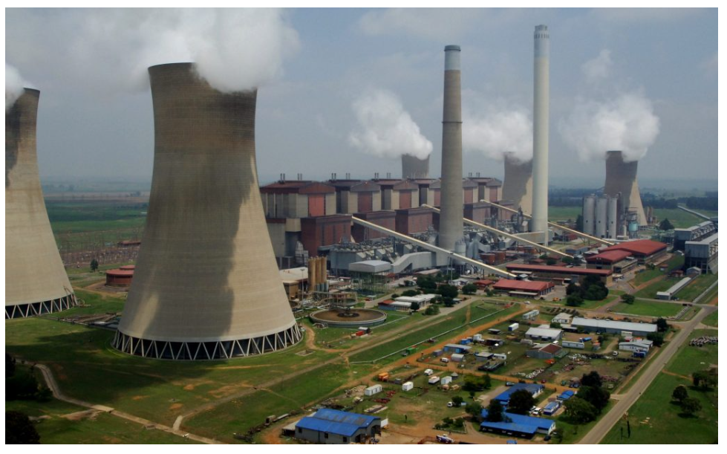
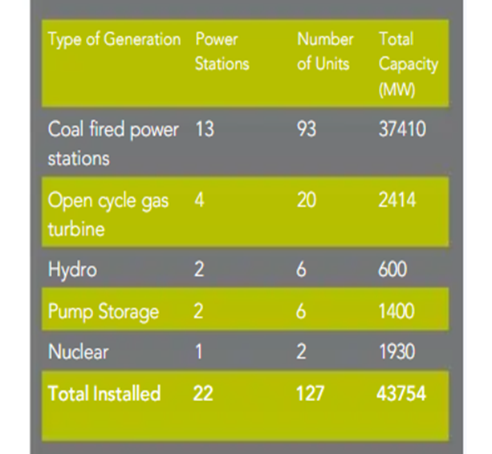
Case Study of Eskom Holdings, SA
Coal-fired Power Stations
Eskom generates about 95% of the electricity used in SA.
95% of Eskom’s generating capacity comes from coal-fired plants.
Emission monitoring systems confirm that about 5 of Eskom’s coal plants exceed statutory emission levels.
Eskom is a state-owned electricity provider.
Profile
(Reference: Reuter's Energy Analysis in South Africa)
Source: https://www.eskom.co.za/about-eskom/company-information/
Source: https://www.eskom.co.za/eskom-divisions/gx/coal-fired-power-stations/

Slide 12
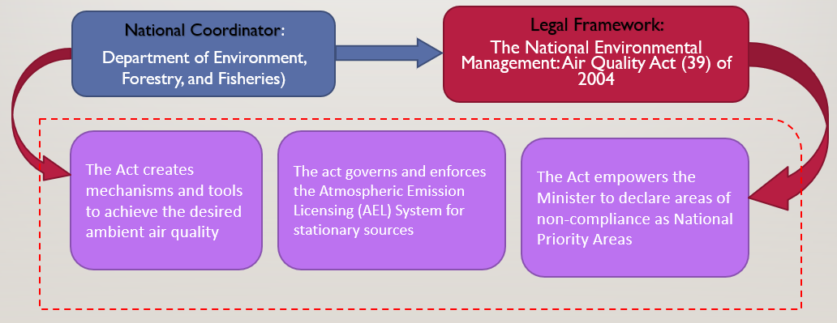
Legislative framework of south Africa
Source: National Environmental Management (Air Quality Act), 2004

Slide 13
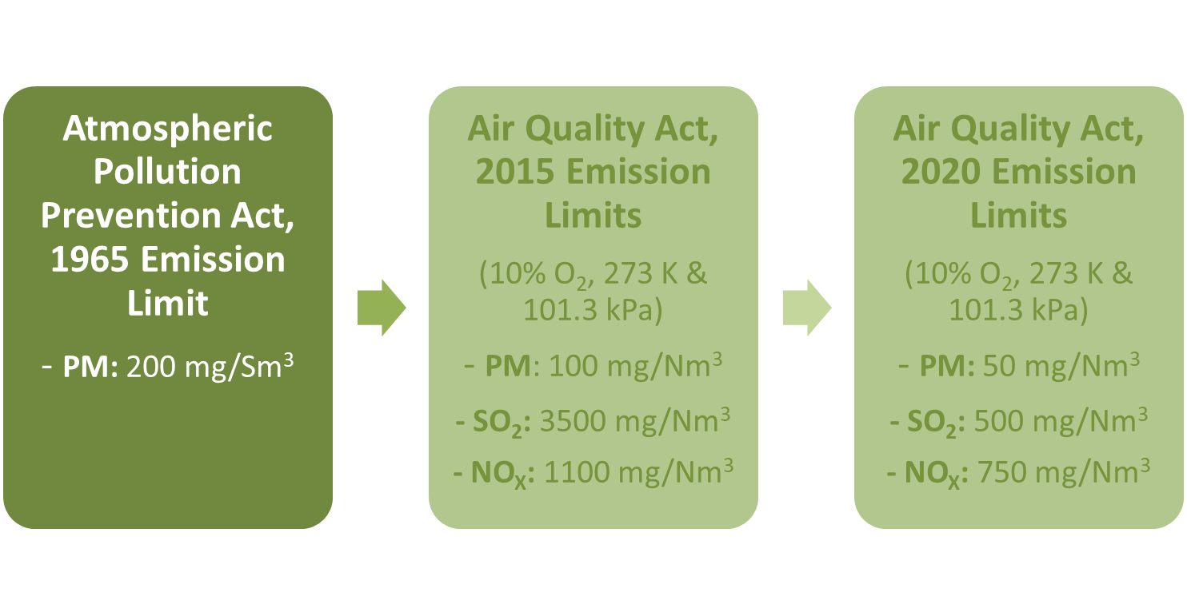
Limiting Standards
Sources: National Environmental Management (Air Quality Act(s))

Slide 14
EMS Installation and Reporting at Eskom
The system utilizes Continuous Emission Monitoring Systems (CEMS) to track emissions of pollutants (oxides of sulfur, nitrogen oxides, and particulate matter).
Data collected from CEMS is analyzed and reported quarterly to regulatory authority to check for compliance with statutory limits and environmental regulations.
Eskom's proactive approach to emission monitoring has contributed to improved ambient air quality in coal-fired plants’ sites
Source: Eskom Status of Compliance with Environmental laws_Report (2021)

Slide 15
Components EMS Installation and Reporting (1)
CEMS consists of advanced instrumentation and sensors installed at emission points (stacks and flues) to measure pollutant concentrations in exhaust gases.
Real-time data collected by CEMS is transmitted to a central monitoring station, for analysis and recording.
Based on emission reports, the Atmospheric Emission License is awarded/renewed by the Coordinating authority.
Source: Eskom Sustainability Report_2021

Slide 16
Components EMS Installation and Reporting (2)
Gas analyzers are employed within CEMS to measure concentrations of specific pollutants, including SO2 and NOx, with high accuracy and precision.
These analyzers utilize techniques such as infrared absorption, chemiluminescence, and ultraviolet fluorescence to detect and quantify pollutant concentrations in emissions.
Source: Eskom Sustainability Report_2022

Slide 17
Components EMS Installation and Reporting (3)
Particulate matter emissions from Eskom's power plants are monitored using particulate matter samplers and analyzers.
These devices collect samples of particulate matter from exhaust gases and analyze them for size distribution, mass concentration, and composition.
Techniques such as beta attenuation, light scattering, and gravimetric analysis are employed for particulate matter monitoring.
Source: Eskom Sustainability Report_2022

Slide 18
Components of EMS Installation and Reporting (4)
Collected emission data from CEMS, gas analyzers, and particulate matter monitors are stored and managed using a centralized data management system.
Eskom's reporting system compiles emission data into comprehensive reports, detailing pollutant concentrations, emission rates, and compliance status.
Reporting is conducted regularly to regulatory authorities, such as the Department of Environment, Forestry, and Fisheries (DEFF), under South Africa's National Environmental Management: Air Quality Act (NEM: AQA) and other relevant regulations.
Source: Eskom Sustainability Report_2022

Slide 19
Conclusion
In terms of regulatory framework both Kenya and South Africa have regulatory frameworks in place to address air quality and stationary emissions defining emission standards, monitoring requirements, and reporting obligations for industries.
They both employ modern monitoring technologies, such as Continuous Emission Monitoring Systems (CEMS), to track pollutants from stationary sources.
Facilities in both countries are required to regularly report their emissions data to relevant environmental authorities depending on regulatory standards.
Due to the continuous evolution of environmental challenges, regulatory frameworks are expected to adapt. Both Kenya and South Africa are involved in continuous improvement efforts, updating standards and monitoring approaches to address emerging environmental concerns.

Slide 20
References
Ciobanu, C., Istrate, I. A., Tudor, P., & Voicu, G. (2021). Dust emission monitoring in cement plant mills: a case study in Romania. International Journal of Environmental Research and Public Health, 18(17), 9096.
Bamburi Cement Limited (BAMB.ke) 2022 annual report. Available at: https://africanfinancials.com/document/ke-bamb-2022-ar-00/ (Accessed: 07 March 2024). (No date b) Bamburi Cement Limited (BAMB.ke) 2022 annual report. Available at:https://africanfinancials.com/document/ke-bamb-2022-ar-00/ (Accessed: 07 March 2024).
Bamburi Cement Limited (BAMB.ke) 2021 annual report. Available at: https://africanfinancials.com/document/ke-bamb-2021-ar-00/ (Accessed: 07 March 2024).
Eskom – Eskom Sustainability Report: UN Global Compact (no date a) Eskom – Eskom Sustainability Report | UN Global Compact. Available at: https://www.unglobalcompact.org/participation/report/cop/create-and-submit/active/458072 (Accessed: 07 March 2024).
Eskom – Eskom Sustainability Report: UN Global Compact (no date b) Eskom – Eskom Sustainability Report | UN Global Compact. Available at: https://www.unglobalcompact.org/participation/report/cop/create-and-submit/active/458072 (Accessed: 07 March 2024).

