Slide 1

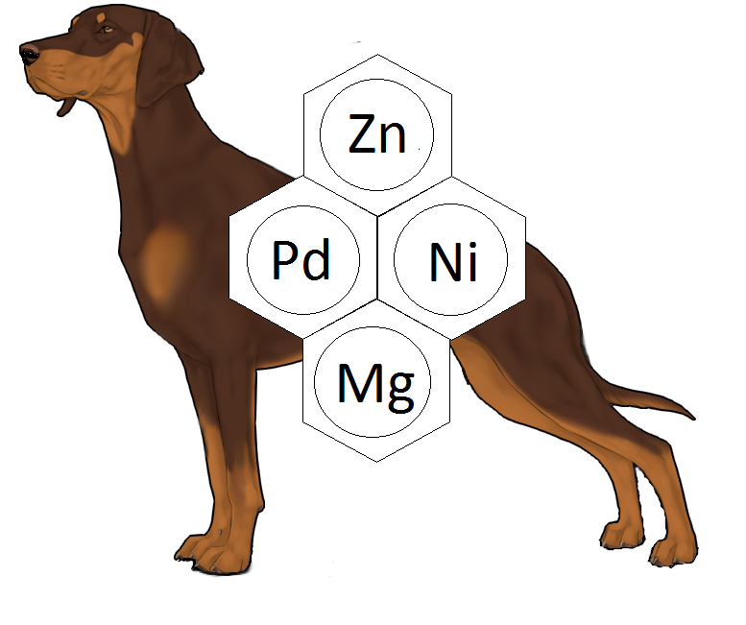
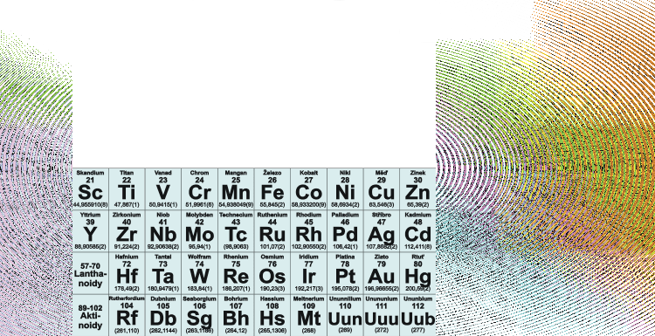
Transition metal complexes
Přechodné kovy v organické syntéze

Slide 2
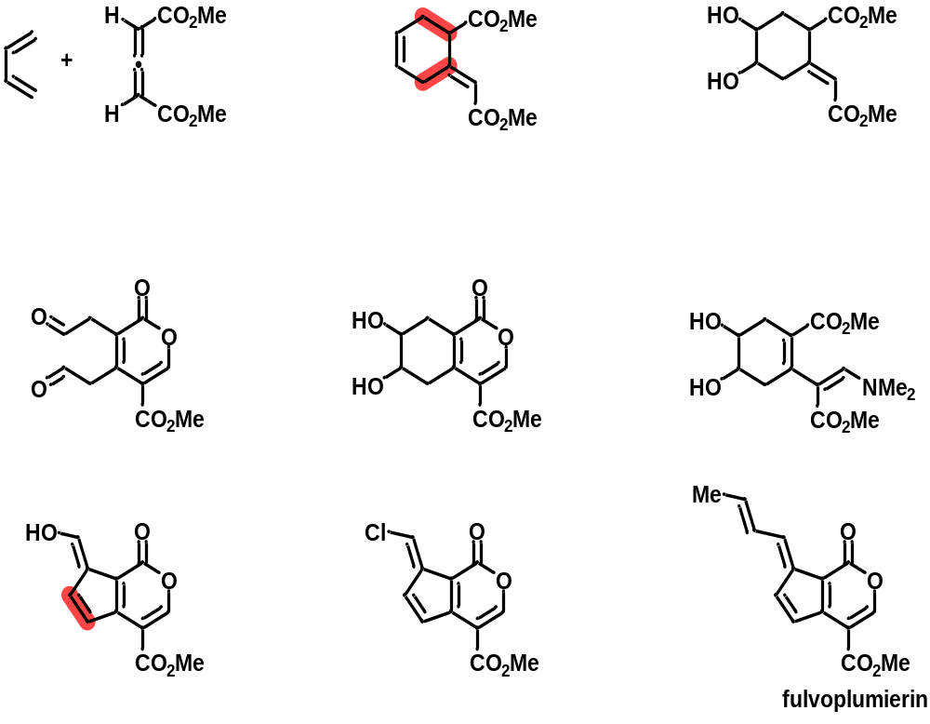
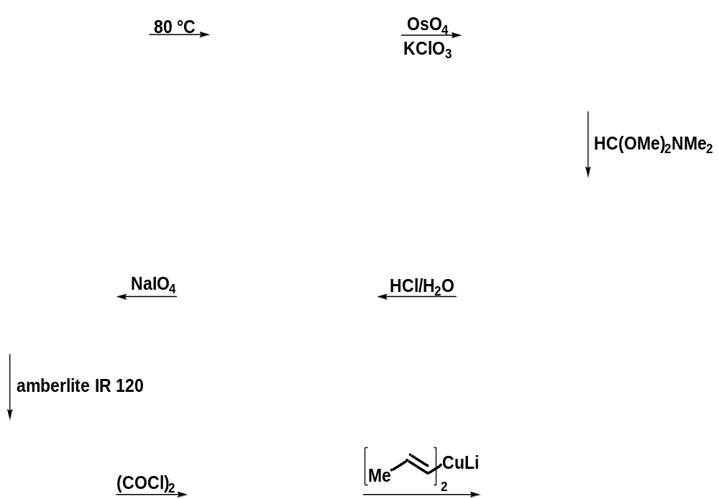
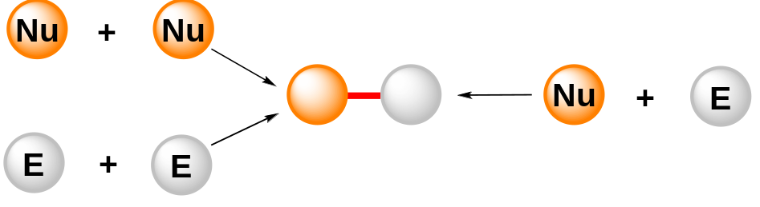
Basic Mechanisms in Organometallic Chemistry
Main objective of organic synthesis – Synthesis of C−C or C−heteroatom bond
J. Am. Chem. Soc. 1968, 90, 5336
Přechodné kovy v organické syntéze

Slide 3
Transition Metal Complexes
The Nobel Prizes in Chemistry
1912 | V. Grignard „for the discovery of the so-called Grignard reagent, which in recent years has greatly advanced the progress of organic chemistry“
1963 | K. Ziegle, G. Natta „for their discoveries in the field of the chemistry and technology of high polymers“
1973 | E. O. Fischer, G. Wilkinson „for their pioneering work, performed independently, on the chemistry of the organometallic, co-called sandwich compounds“
2001 | W. Knowles, R. Noyori, K. B. Sharpless „for their work on chirally catalysed hydrogenation reactions“
2005 | Y. Chauvin, R. H. Grubbs, R. R. Schrock „for the development of the metathesis method in organic synthesis“
2010 | R. F. Heck, E.-i. Negishi, A. Suzuki „for palladium-catalyzed cross-couplings in organic synthesis“
Přechodné kovy v organické syntéze

Slide 4
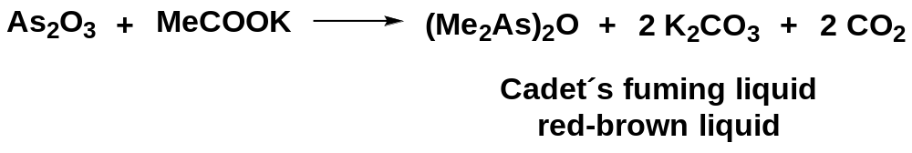
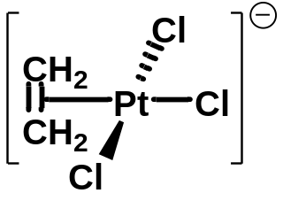
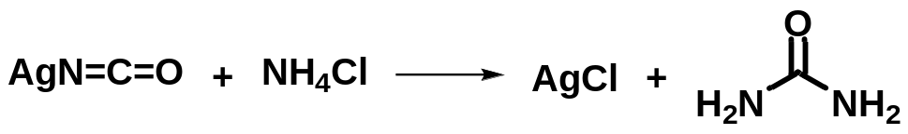
Transition Metal Complexes
Milestones
1760
1727 Dutch scientist Heman Boerhaave discovered H₂NCONH₂
1828 Urea was synthesized by Friedrich Wöhler
1827 Zeise´s salt
1852 Franklad prepared MeHgI
1938 O. Roelen discovered hydroformylation
1951 P. Pauson synthesized ferrocene
1952 H. Gilman established organocuprates
1964 E. O. Fischer synthesized the first carbene complex
1969 A. E. Shilov discovered Pt^{II}-catalyzed H/D Exchange of alkene with solvents → C−H activation
Přechodné kovy v organické syntéze

Slide 5
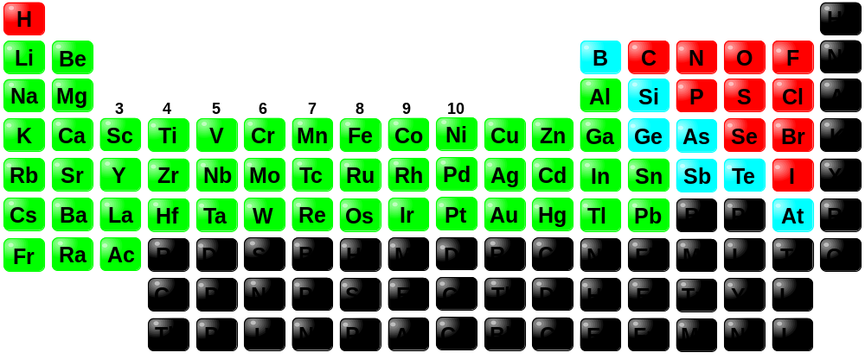
Transition Metal Complexes
Periodic table of the elements
Přechodné kovy v organické syntéze

Slide 6
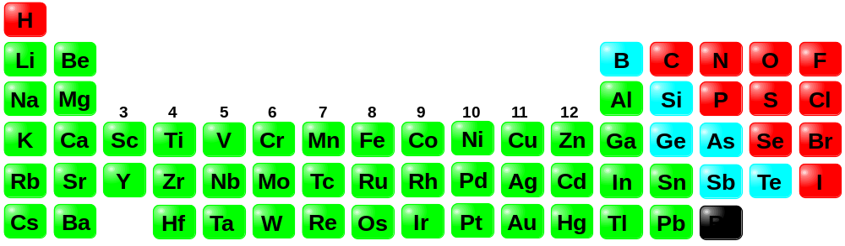
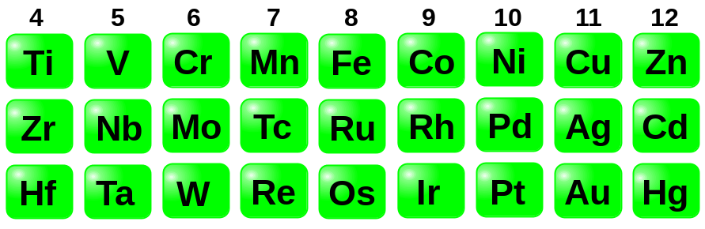
Transition Metal Complexes
Modified periodic table of the elements
Our periodic table of the elements
Přechodné kovy v organické syntéze

Slide 7

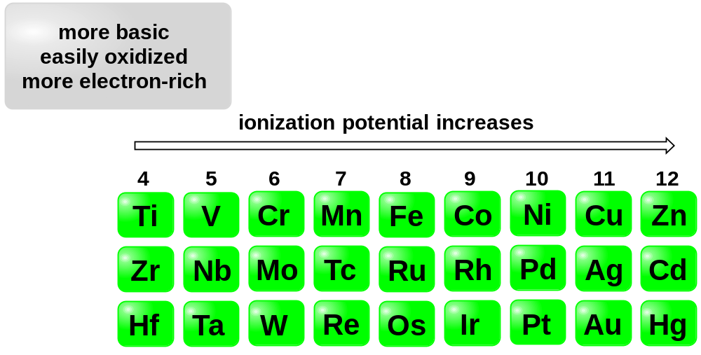
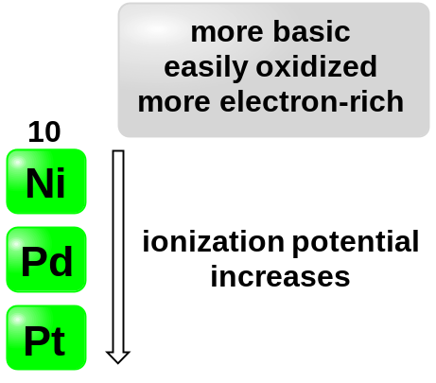
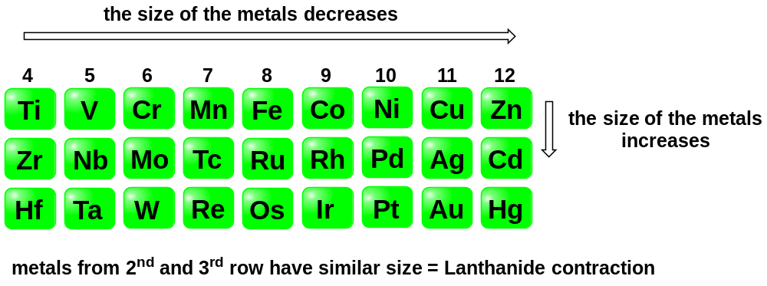
Transition Metal Complexes
Properties of transition metals
Ionization potentials
Size
Přechodné kovy v organické syntéze

Slide 8
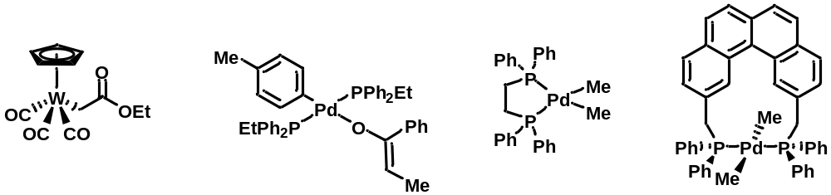
Transition Metal Complexes
Examples of organometallic compounds
Přechodné kovy v organické syntéze

Slide 9
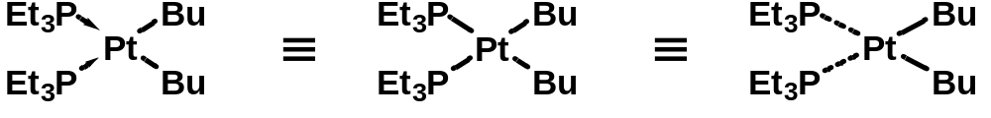
Transition Metal Complexes
Structure of transition metal complexes − Ligand properties
The 18-electron rule − coordinatively saturated (18 electrons) or unsaturated complexes (<18 electrons)
Coordination number − number of ligands bounded to the metal by σ-bonds
Hapticity (η) describes how many atoms of the ligand bind to the transition metal
Monodentate or polydentate ligands
Přechodné kovy v organické syntéze

Slide 10
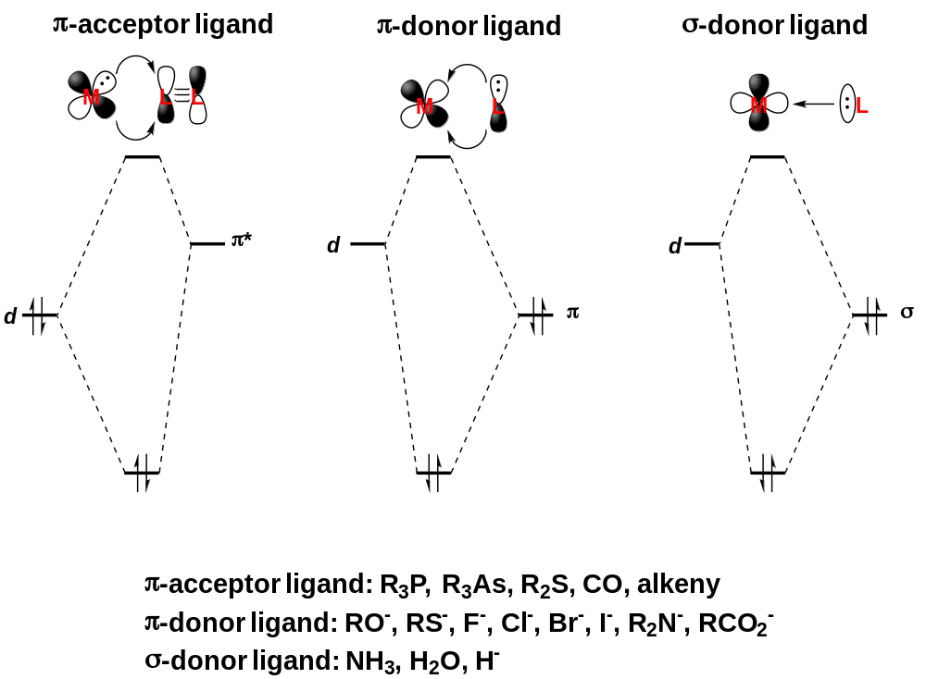
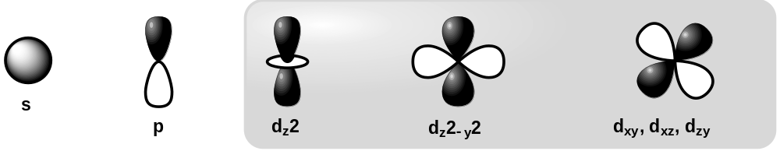
Transition Metal Complexes
Structure of transition metal complexes − Bindings in transition metal complexes
Přechodné kovy v organické syntéze

Slide 11
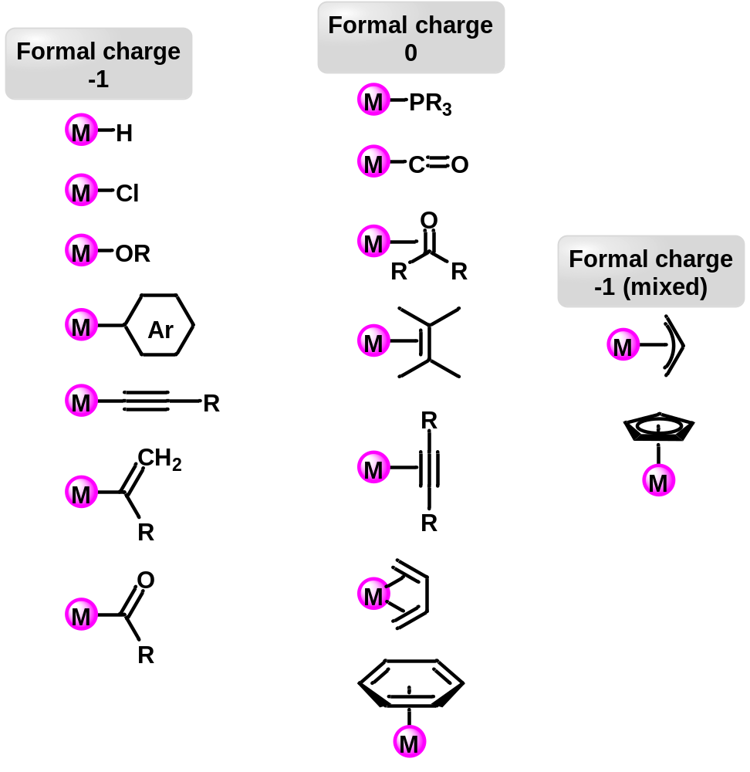
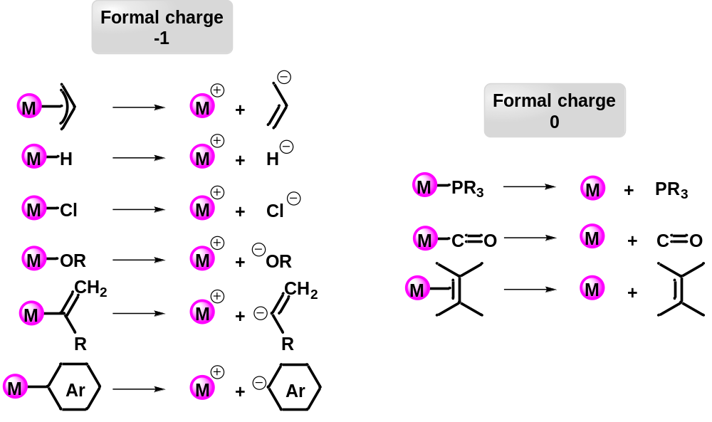
Transition Metal Complexes
Structure of transition metal complexes − 18 electron rule
Přechodné kovy v organické syntéze

Slide 12
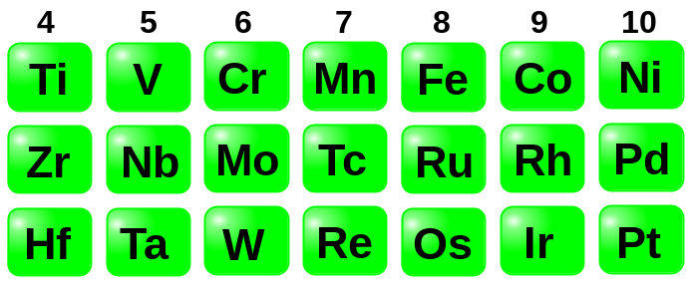
Transition Metal Complexes
Structure of transition metal complexes − Oxidation state of transition metal and number of d-electrons
Oxidation state |  | Number of d-electrons
 | 0 | 4 | 5 | 6 | 7 | 8 | 9 | 10
 | I | 3 | 4 | 5 | 6 | 7 | 8 | 9
 | II | 2 | 3 | 4 | 5 | 6 | 7 | 8
 | III | 1 | 2 | 3 | 4 | 5 | 6 | 7
 | IV | 0 | 1 | 2 | 3 | 4 | 5 | 6
Přechodné kovy v organické syntéze

Slide 13
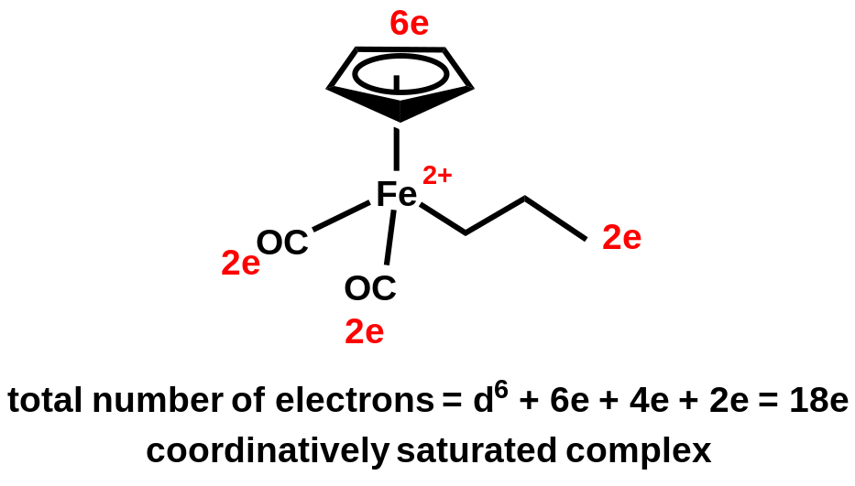
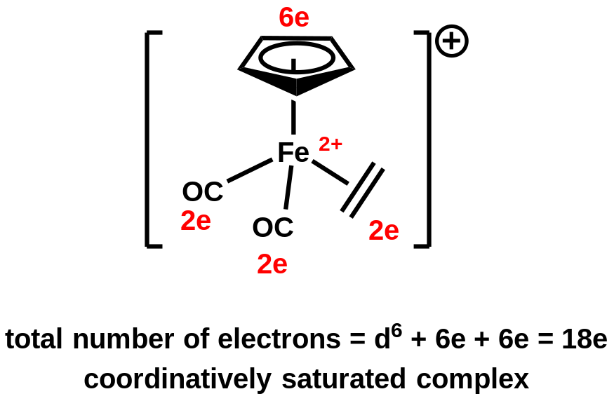
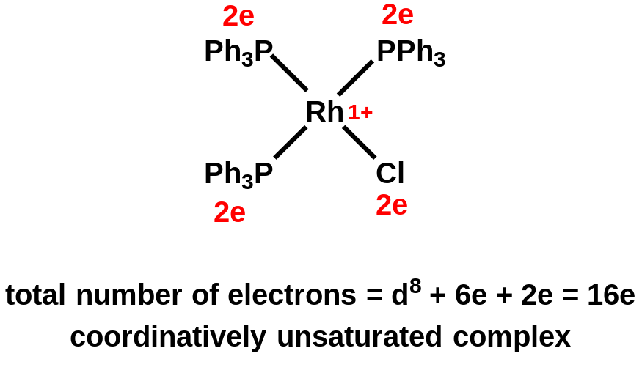
Transition Metal Complexes
Structure of transition metal complexes − 18 electron rule
Přechodné kovy v organické syntéze

Slide 14
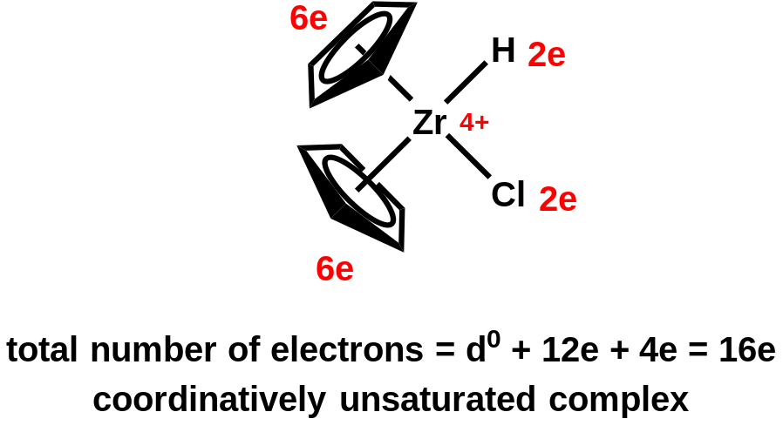
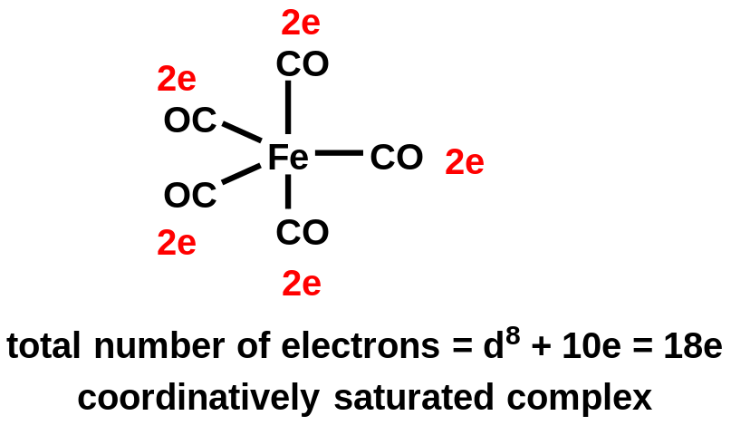
Transition Metal Complexes
Structure of transition metal complexes − 18 electron rule
Přechodné kovy v organické syntéze

Slide 15
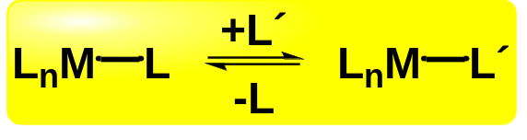
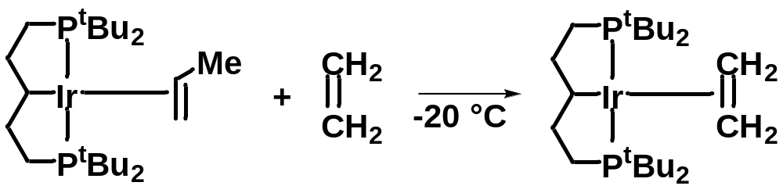
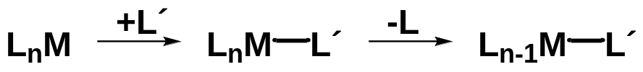
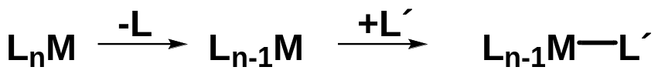
Basic Mechanisms in Organometallic Chemistry
Ligand substitution
Science 2005, 307, 1080.
Associative mechanism (S_{N}2)
Dissociative mechanism (S_{N}1)
Přechodné kovy v organické syntéze

Slide 16
Basic Mechanisms in Organometallic Chemistry
Ligand substitution
Associative mechanism (S_{N}2)
Dissociative mechanism (S_{N}1)
Occurs with 16e and 17e complexes
Favored for more electrophilic metals
Favored for more basic attacking ligand
Departing ligand negligibly affects substitution
Metal should be sterically accessible
Typical for square-planar 16-electron complexes
(Pd^{II}, Ni^{II}, Au^{III}, Rh^{I}, Ir^{I})
Typicall for 18e complexes
Favored for electron-rich and electron-poor metals
Favored for sterically hindered metals
Přechodné kovy v organické syntéze

Slide 17
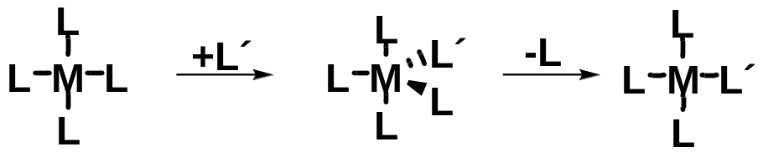
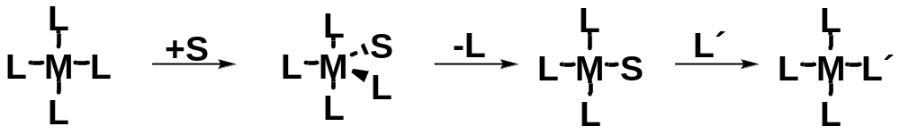
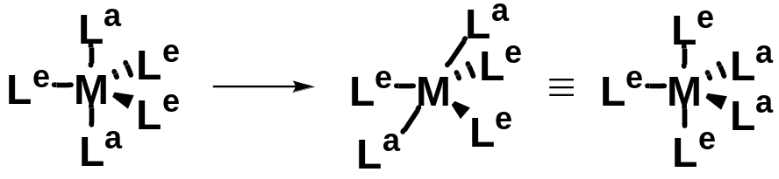
Basic Mechanisms in Organometallic Chemistry
Ligand substitution
Associative mechanism (S_{N}2)
Without solvent participation
With solvent participation
Associative mechanism is stereoselective!
Ligand cis-trans isomerization − pseudorotation ! (Berry)
Přechodné kovy v organické syntéze

Slide 18
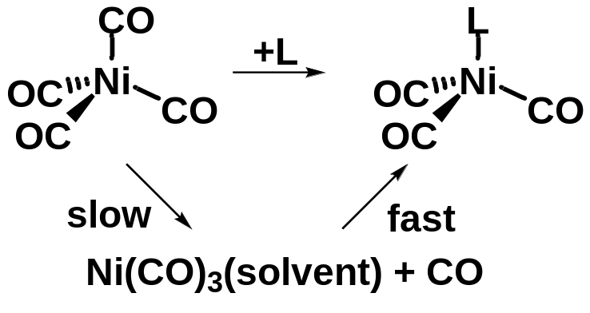
Basic Mechanisms in Organometallic Chemistry
Ligand substitution
Dissociative mechanism (S_{N}1)
Ligand elimination is ussually slow
J. Am. Chem. Soc. 1968, 90, 6927; Inorg. Chim. Acta 1981, 50, 65
Chem. Rev. 1983, 83, 557.
Racemization occurs during dissociative mechanism
Přechodné kovy v organické syntéze

Slide 19
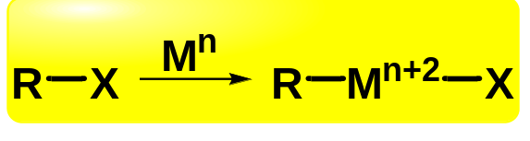
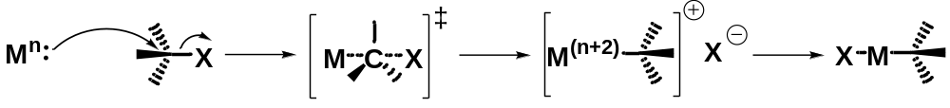
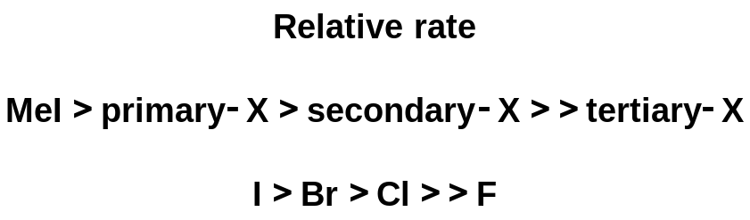
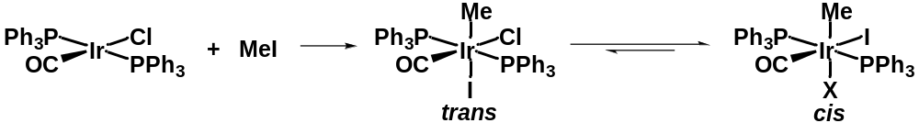
Basic Mechanisms in Organometallic Chemistry
Oxidative addition
Oxidative addition by S_{N}2 mechanism
Typical for Vaska´s complex
Přechodné kovy v organické syntéze

Slide 20
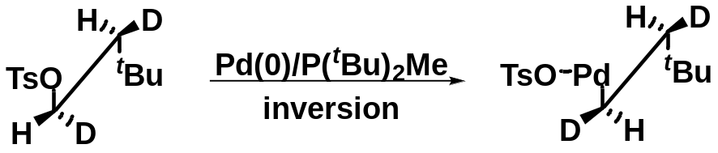
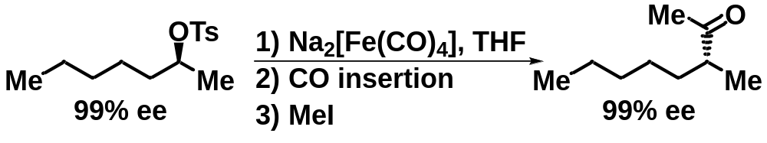
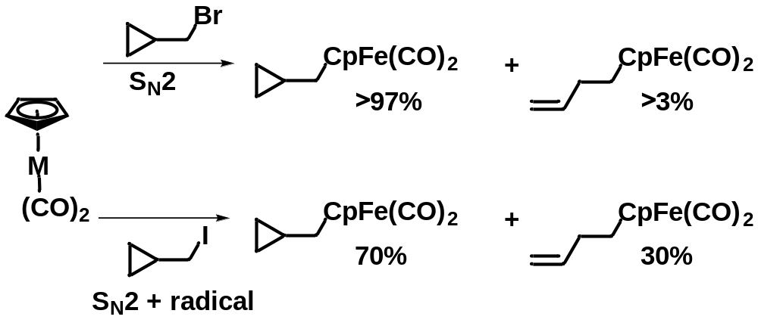
Basic Mechanisms in Organometallic Chemistry
Oxidative addition
Oxidative addition by S_{N}2 mechanism
J. Chem. Soc., Dalton Trans. 1984, 1171
Přechodné kovy v organické syntéze

Slide 21
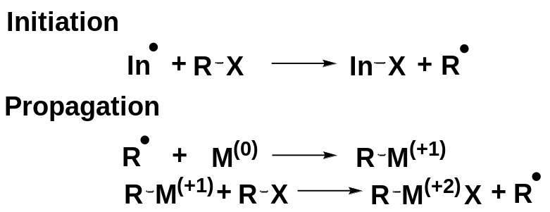
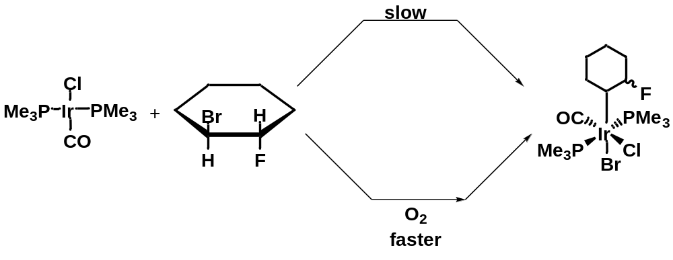
Basic Mechanisms in Organometallic Chemistry
Oxidative addition
Radical chain oxidative addition
Only for coordinatively unsaturated complexes
requires radical initiator
Inhibited by hydroquinones
Racemization occured
Inorg. Chem. 1984, 23, 649; Acc. Chem. Rec. 1984, 17, 221
Přechodné kovy v organické syntéze

Slide 22
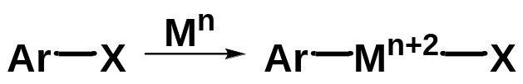
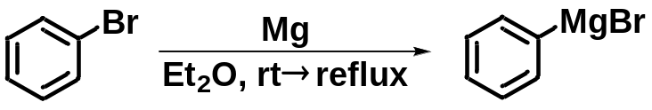
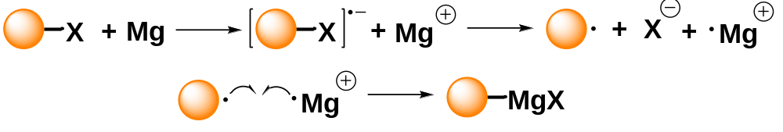
Basic Mechanisms in Organometallic Chemistry
Oxidative addition
Concerted oxidative addition (Typical for aryl halides)
Example of oxidative addition from traditional chemistry
Přechodné kovy v organické syntéze

Slide 23
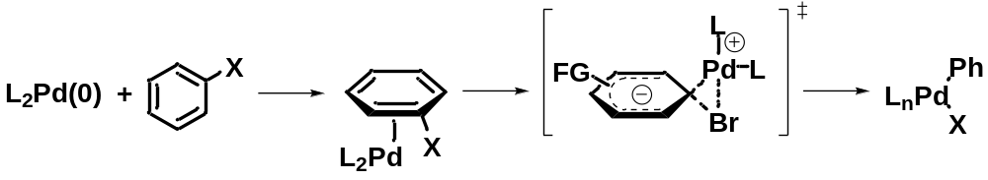
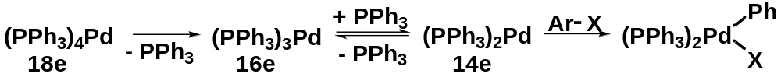
Basic Mechanisms in Organometallic Chemistry
Oxidative addition
Concerted oxidative addition (Typical for aryl halides)
Proposed mechanism
ArI > ArBr > ArCl and EWG-ArX > EDG-ArX
12e or 14e Pd-complexes are the most reactive
Přechodné kovy v organické syntéze

Slide 24
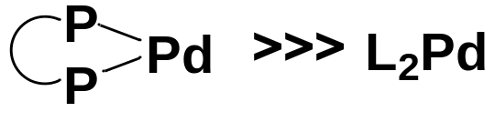
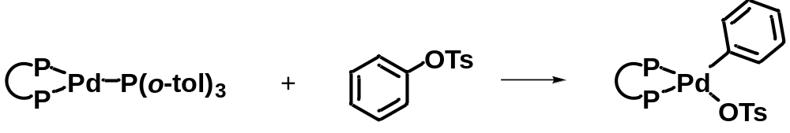

Basic Mechanisms in Organometallic Chemistry
Oxidative addition
Concerted oxidative addition (Typical for aryl halides)
Complexes with a bidentate ligand are more reactive (The complex is bent to a less stable conformation)
Tetrahedron Lett. 1998, 39, 6163
Extremely hindered P-ligands must dissociate before the oxidative addition
Angew. Chem. Int. Ed. 2003, 42, 5355
Complexes with alkylphosphine ligands react with aryl chlorides faster then complexes with arylphosphines
Angew. Chem. Int. Ed. 2004, 43, 2968; Angew. Chem. Int. Ed. 2004, 43, 3955
Přechodné kovy v organické syntéze

Slide 25





Basic Mechanisms in Organometallic Chemistry
Transmetallation
Concerted mechanism
Transmetallation mechanism depends on reaction conditions
J. Am. Chem. Soc. 2004, 126, 4876
J. Am. Chem. Soc. 2004, 126, 4865
Přechodné kovy v organické syntéze

Slide 26



Basic Mechanisms in Organometallic Chemistry
Transmetallation
Sn→Pd transmetalation starts by coordination
J. Am. Chem. Soc. 1998, 120, 11016
J. Am. Chem. Soc. 1983, 105, 6129
Tetrahedron Lett. 1993, 34, 8007
Přechodné kovy v organické syntéze

Slide 27



Basic Mechanisms in Organometallic Chemistry
Reductive elimination for the formation of C−C bond
Reverse proces to oxidative addition
Typical for cis-complexes
First row complexes react faster then second row
Complexes with sterically more hindered ligands
are more reactive
Electron-poor metal centers eliminate faster
J. Am. Chem. Soc. 1979, 101, 4981
Přechodné kovy v organické syntéze

Slide 28


Basic Mechanisms in Organometallic Chemistry
Reductive elimination for the formation of C−C bond
Higher ligand bite angle = better reductive elimination
The rate of reductive elimnation is affected
by electronic properties – pairing is the best option
Inorg. Chim. Acta. 1994, 220, 249
J. Am. Chem. Soc. 2004, 126, 13016
Přechodné kovy v organické syntéze

Slide 29

Basic Mechanisms in Organometallic Chemistry
Quick summary
Finished
Coming soon
Přechodné kovy v organické syntéze

